Slide 1
Least Square Solutions
Reporter: Huang Yangyang, Xiao Shuisheng
2018-11-19

Slide 2
Overview
Least squares
Problem && Algorithm
Optimality
Generalized errors
Robust least squares
Least-squares solutions to large, sparse matrix

Slide 3
Overview
Least squares
Problem && Algorithm
Optimality
Generalized errors
Robust least squares
Least-squares solutions to large, sparse matrix

Slide 4
Problem && Algorithm
Given a Point set , find the best fit hyperplane
Suppose model from which data is observed: h(x) = w^{T}x
Notes:
\begin{equation*}X={\left\{ \begin{array}{ccccc}1, & x_{1}, & x_{2}, & ... & x_{d}\\\end{array}\right \}^{T}}\end{equation*}

Slide 5
Problem && Algorithm
Error measure : squared error
how to minimize E(w)?

Slide 6
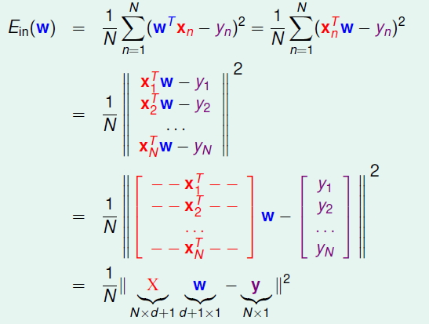
Matrix Form of E_{in}(w)

Slide 7
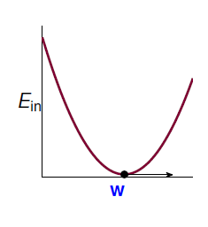
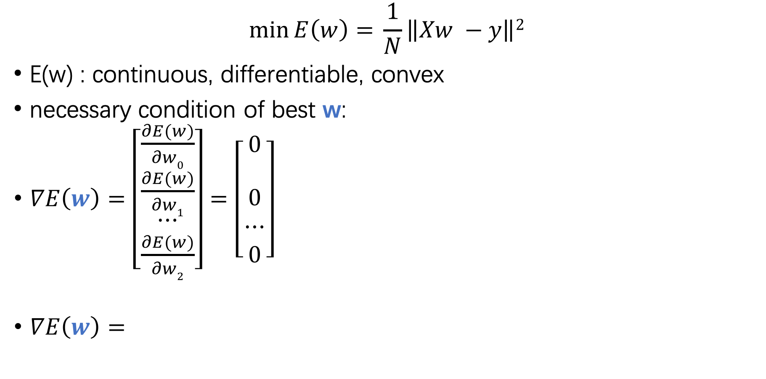
$$\min{E\left(w\right)= }\frac{1}{N}\left\|Xw −y\right\|2$$
E(w) : continuous, differentiable, convex
necessary condition of best w:
$∇E\left(w\right)=\left[\begin{matrix}\frac{∂E(w)}{∂w0} \\ \frac{∂E(w)}{∂w1} \\ \begin{matrix}⋯ \\ \frac{∂E(w)}{∂w2}\end{matrix}\end{matrix}\right]=\left[\begin{matrix}0 \\ \\ \begin{matrix}0 \\ ⋯ \\ 0\end{matrix}\end{matrix}\right]$
$∇E\left(w\right)=$

Slide 8
Minimizing w yields the equation
X^{T}X is non-singular, invertible X^{T}X:
Symmetric and orthogonal
is orthogonal to the residual
X^{T}X is singular solution is not unique

Slide 9
Overview
Least squares
Problem && Algorithm
Optimality
Generalized errors
Robust least squares
Least-squares solutions to large, sparse matrix

Slide 10
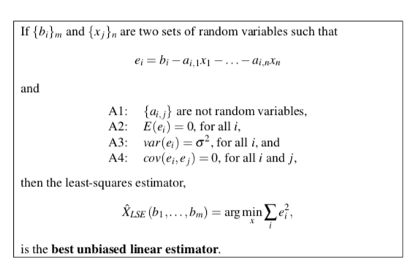
Optimality
Gauss-Markow theorem
Notes:
在估计理论中，最小平法法被叫做估计量，估计量即一个函数，以样本数据作为输入，产生一组参数的估计。估计量的目的是产生最优的估计

Slide 11
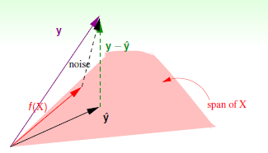
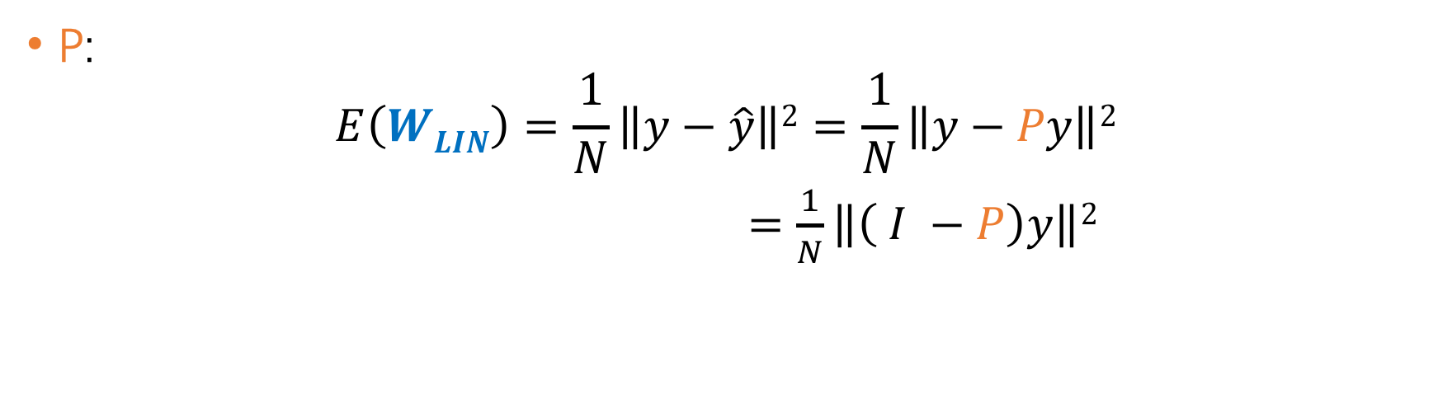
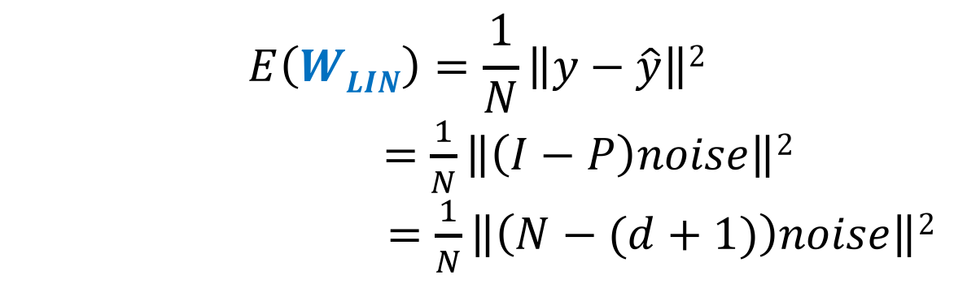
Optimality
P:
$$E\left(WLIN\right)=\frac{1}{N}\left\|y−\hat{y}\right\|2=\frac{1}{N}\left\|y−Py\right\|2$$
$=\frac{1}{N}\left\|\left( I −P\right)y\right\|2$
$$E\left(WLIN\right)=\frac{1}{N}\left\|y−\hat{y}\right\|2$$
$=\frac{1}{N}\left\|\left(I−P\right)noise\right\|2$
$=\frac{1}{N}\left\|\left(N−(d+1)\right)noise\right\|2$

Slide 12
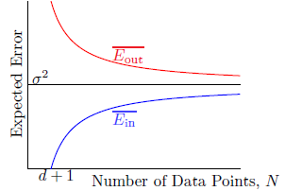
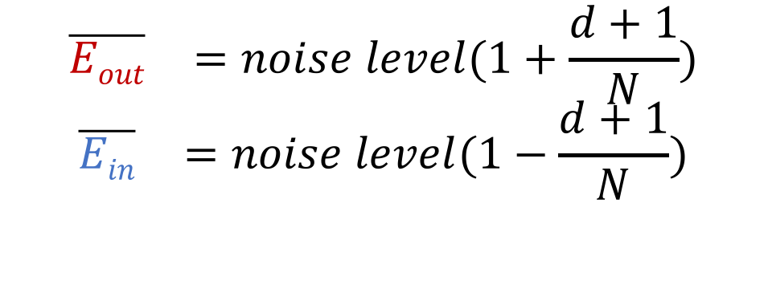
Optimality
$$\begin{matrix}\overline{Eout} & =noise level(1+\frac{d+1}{N})\end{matrix}$$
$$\begin{matrix}\overline{Ein} & =noise level(1−\frac{d+1}{N})\end{matrix}$$

Slide 13
Overview
Least squares
Problem && Algorithm
Optimality
Generalized errors
Robust least squares
Least-squares solutions to large, sparse matrix

Slide 14
Generalized errors
The error on the data samples have different variance?
Assuming that
Weighted least-squares
Call

Slide 15
Overview
Least squares
Problem && Algorithm
Optimality
Generalized errors
Robust least squares
Least-squares solutions to large, sparse matrix

Slide 16
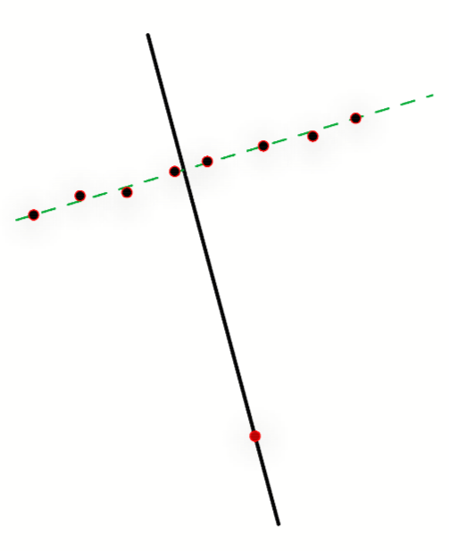
Robust Least Squares
Outlying point can severely affect least squares estimate
Redescending estimators

Slide 17
Robust Least Squares
Iteratively reweighted least-squares
The algorithm converges for 1 < p < 3

Slide 18
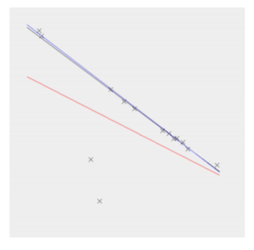
Robust Least Squares
Least Median of Squares
Randomly select k points
Fit the model to these points
Evaluate quality of fit on remaining points

Slide 19
Overview
Least squares
Problem && Algorithm
Optimality
Generalized errors
Robust least squares
Least-squares solutions to large, sparse matrix

Slide 20
Least squares solutions for sparse matrix
Conjugate Gradient
LSQR,
Notes:
解线性方程组的直接解法如高斯消元法需要O(n3)，且需要存储矩阵，

Slide 21
Conjugate Gradient
Equal problem:
A is symmetric, positive-definite and real
Two non-zero vector x, y are conjugate if
Supposed which is mutually conjugate respect to A, forms a basis for R^{n} , each x can be expressed by:

Slide 22
Conjugate Gradient
n iteration to calculate solution
Notes:
\mathop{min}\limits_{a_{1},...a_{n} \in R^{n}} \frac{1}{2}(\sum_{i=1}^{n}a_{i}d_{i})^{T} A (\sum_{j=1}^{n}a_{j}d_{j}) - b^{T}(\sum_{i=1}^{n}a_{i}d_{i})
= \mathop{min}\limits_{a_{1},...a_{n} \in R^{n}} \sum_{i=1}^{n}(\frac{1}{2}a_{i}^{2}d_{i}^{T} A d_{i} - a_{i}b^{T}d_{i})

Slide 23
Conjugate Gradient
Iterative Method
Taking p₀ = b – Ax₀ , enforce p_{k} to be conjugate to the gradient

Slide 24
Conjugate Gradient
Following d_{k} direction, the next optimal location is:

Slide 25
Least Square Solutions
Conjugate Gradient
LSQR
Notes:
解线性方程组的直接解法如高斯消元法需要O(n3)，且需要存储矩阵，

Slide 26
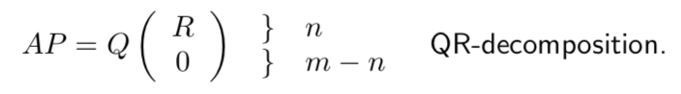
LSQR
Let m ≥ n. For each A ∈ R_{m×n} there exists a permutation matrix P ∈ R_{n×n}, an orthogonal matrix Q ∈ R_{m×m}, and an upper triangular matrix R ∈ R_{n×n} such that

Slide 27
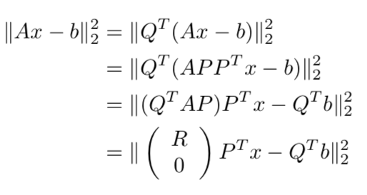
LSQR
Using properties of Q, let

Slide 28
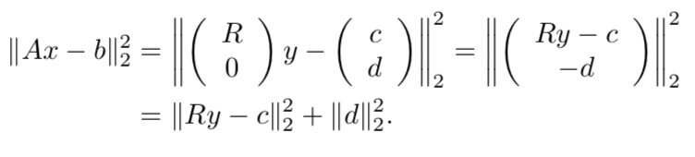
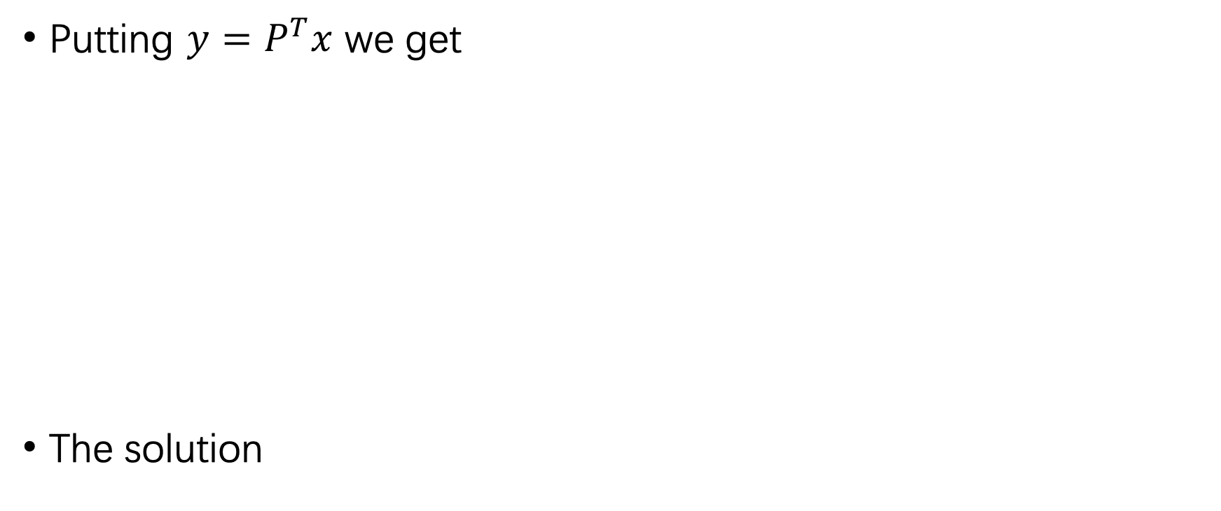
LSQR
Putting $y=P^{T}x$ we get
The solution

Slide 29
LSQR
If A has low column rank. LSQR returns the solution of minimum length
LSQR is recommended for compatible system Ax = b, but it should not be used for symmetric matrix.

Slide 30
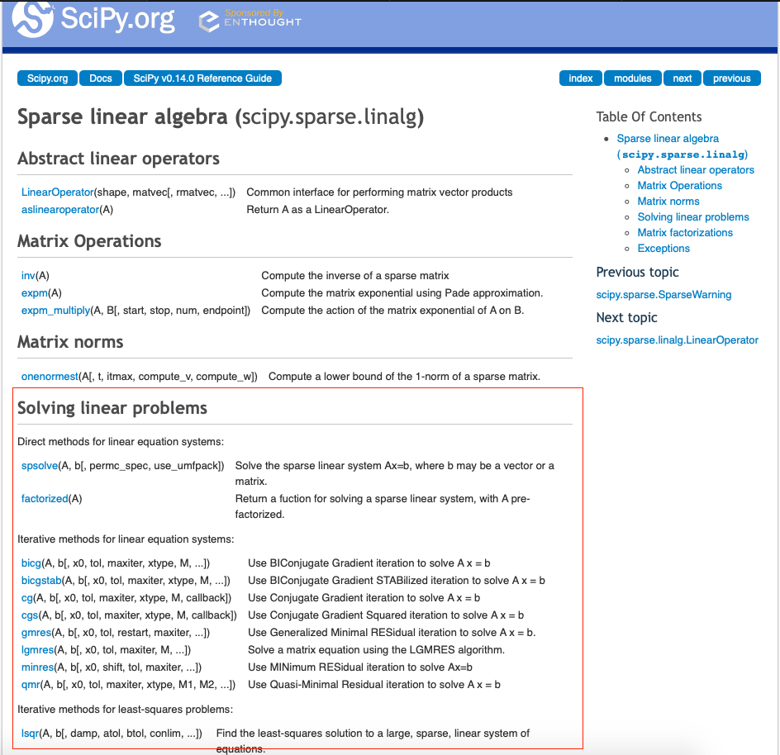
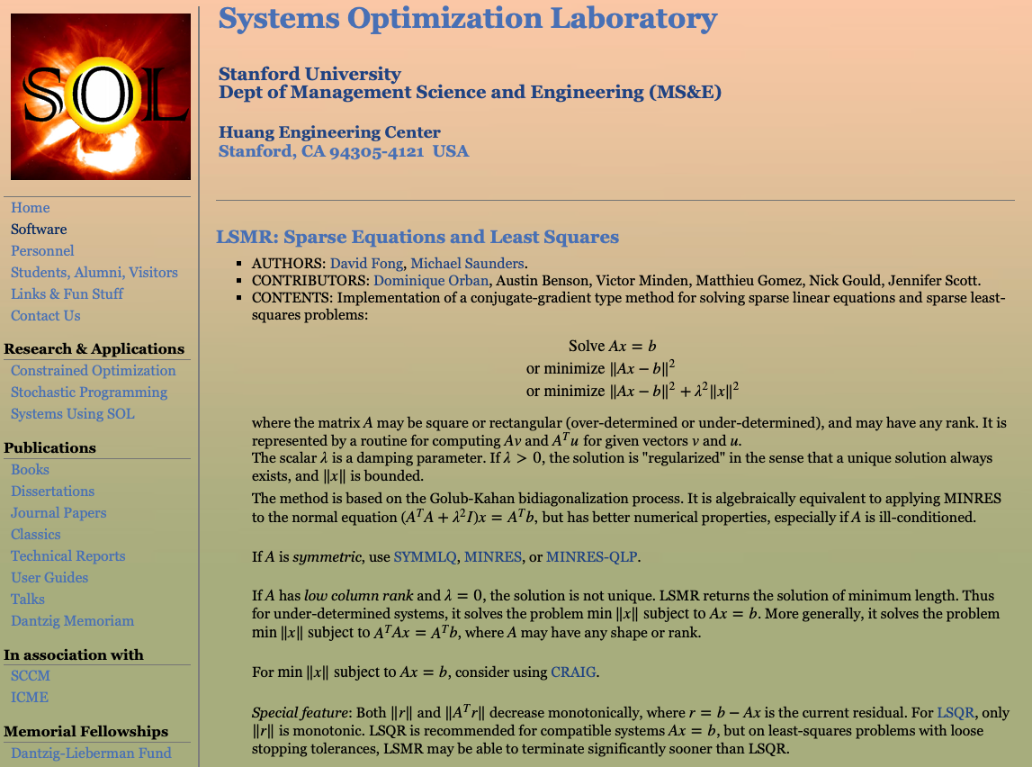
Implementation

Slide 31
Least Squares Application

Slide 32
Local surface fitting to 3D points
Mesh reconstruction
Skin weights computation from examples

Slide 33
Local surface fitting to 3D points
Mesh reconstruction
Skin weights computation from examples

Slide 34
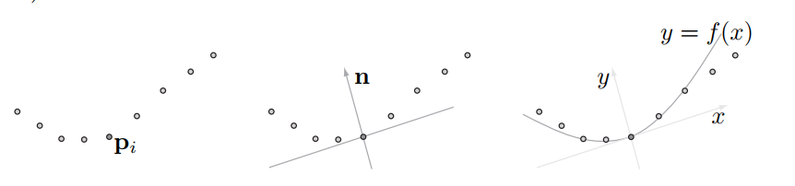
Local surface fitting to 3D points
LS is useful to fit a polynomial to a set of points coming from a curve.
It is also important to locally fit a polynomial surface to a set of points in 3D.

Slide 35
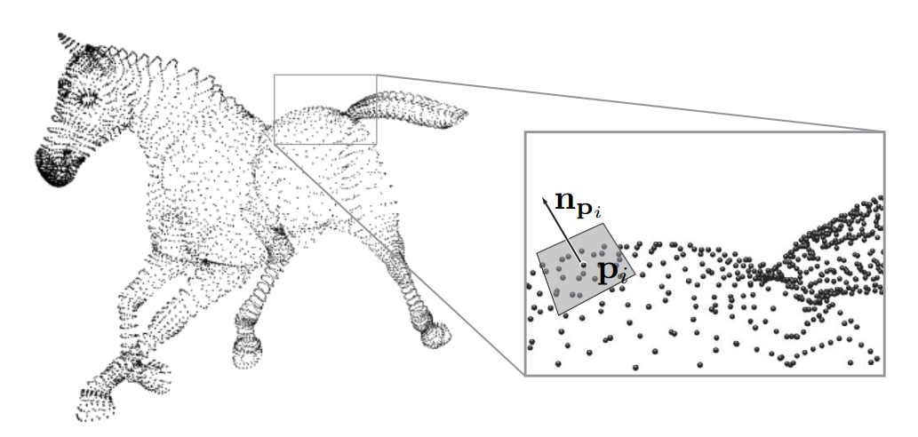
Local surface fitting to 3D points

Slide 36
Local surface fitting to 3D points
First: for a given point p, calculate the unit normal vector n to the surface at p.
Consider point set $N_{r}\left(p\right)=\{q_{i}\}$, $\left\|p−q_{i}\right\|<r_{i}$
The local reference plane can be denoted by
$$n^{T}x+d=0$$
We want to find the plane that best fit the point set $N_{r}\left(p\right)$.
$$\min_{n,d}{(n^{T}x+d)}^{2}$$
with respect to $\left\|n\right\|=1$

Slide 37
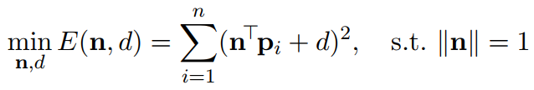
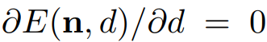
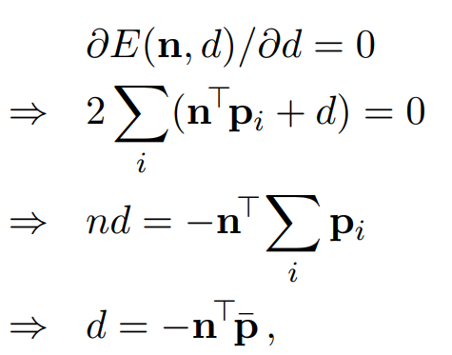
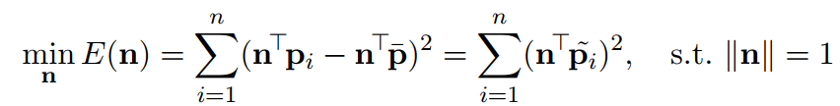
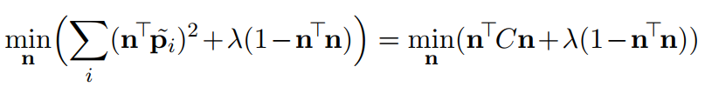
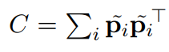
Local surface fitting to 3D points
For the problem:
:

Slide 38
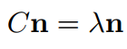
Local surface fitting to 3D points
We get:
$$\min_{n} λ$$
n is the eigenvector of the smallest eigenvector of covariance matrix C.
$d=−n^{T}\overline{p}$

Slide 39
Local surface fitting to 3D points
Then: since we have a local reference plane, we can locally fit a polynomial around the point.
In the reference plane, the polynomial surface can be given by:
$$z=F\left(x,y\right)=ax^{2}+bxy+cy^{2}+dx+ey+f$$
To fit the polynomial surface, we are trying to minimize
$$\sum_{i}{{w_{i}\left\|z_{i}−F(x_{i},y_{i})\right\|}^{2}}$$
by LS.

Slide 40
Local surface fitting to 3D points
Mesh reconstruction
Skin weights computation from examples

Slide 41
Mesh reconstruction
Mesh reconstruction: construction of a mesh from a set of samples.
Given a planar graph with arbitrary connectivity and a sparse set of control points with geometry, reconstruct the geometry of the rest of the mesh vertices.

Slide 42
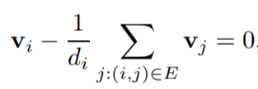
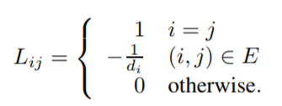
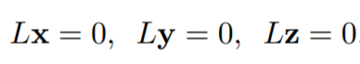
Mesh reconstruction
The smoothness of the reconstructed mesh at a vertex $v_{i}$ is enforced by the construction:
Define Laplacian of the mesh:

Slide 43
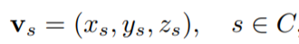
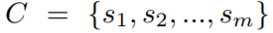
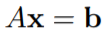
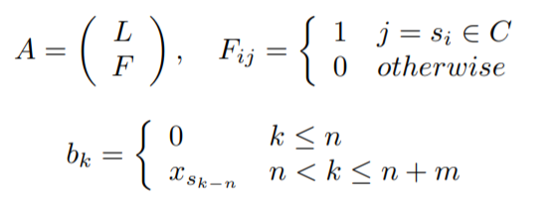
Mesh reconstruction
In order to keep sharp features of the mesh, consider we have some control points:
The system becomes:

Slide 44
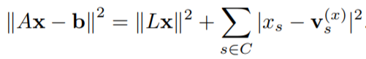
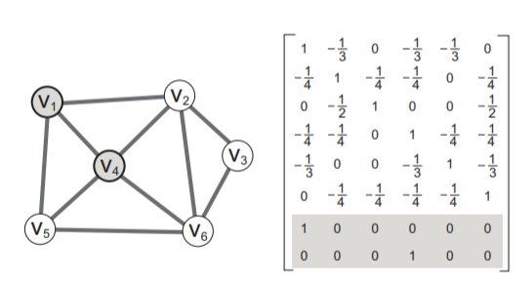
Mesh reconstruction
To reconstruct the mesh, we find x that minimizes:
in least-squares sense.

Slide 45
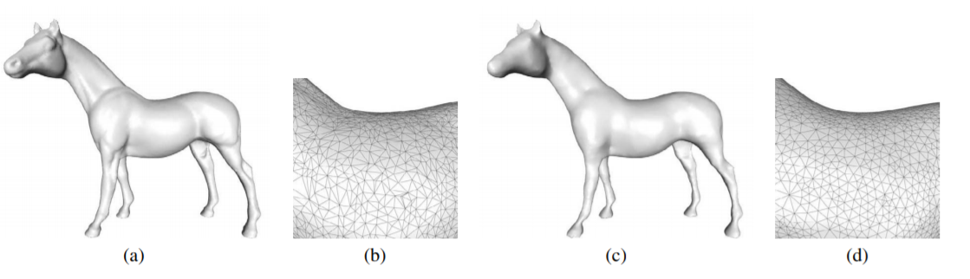
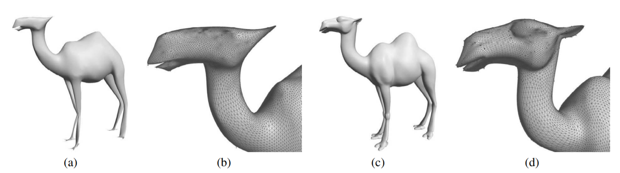
Mesh reconstruction
O. Sorkine and D. Cohen-Or. Least-squares meshes.

Slide 46
Local surface fitting to 3D points
Mesh reconstruction
Skin weights computation from examples

Slide 47
Skin weights computation from examples
Animating articulated characters such as virtual humans is a fundamental operation in computer graphics and interactive applications.
Techniques for rigging character skins by weighting vertices to an associated skeleton are widely used in video games and the computer animation industry.

Slide 48
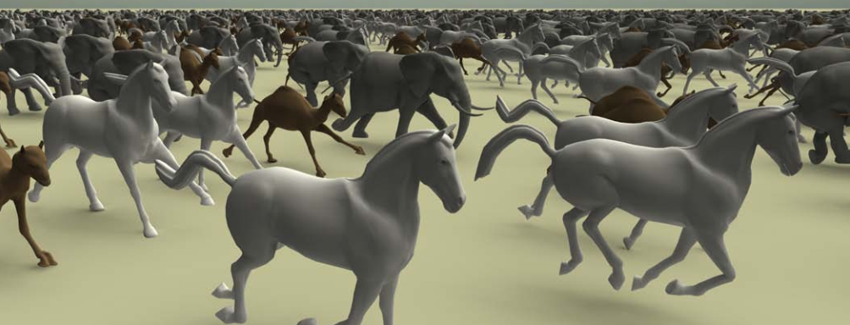
Skin weights computation from examples
?
D. L. James and C. D. Twigg. Skinning mesh animations

Slide 49
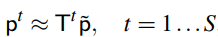
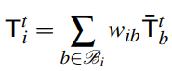
Skin weights computation from examples
For skinning transformation $T^{i}$ at time step t, the approximation $p_{}^{t}$ of $\tilde{p}$ is:
For vertex $i$, the transformation is
We can use least squares to calculate weights $w_{ib}$ from examples

Slide 50
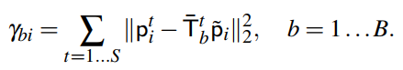
Skin weights computation from examples
Estimating Bone Influence
User specify a maximum number of per-vertex bones, $β.$ For every vertex, we estimate the influence of every bone by sum of squared errors.
Then pick the bones that has smallest squared errors.

Slide 51
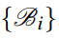
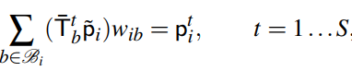
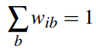
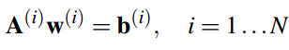
Skin weights computation from examples
Estimating vertex weights:
Given vertex-bone influence sets, , the associated weights are computed using a least squares approach.
Weights are constrained by the mesh sequence approximation equations:
It is of the form:

Slide 52
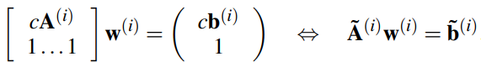
Skin weights computation from examples
We consider the augment system:
Then solve the over-constrained system by least squares.

Slide 53
Skin weights computation from examples
Over-fitting:
The solution can result in weights with large positive and negative values.
TSVD, NNLS

Slide 54
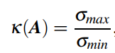
TSVD(Truncated SVD)
TSVD(Truncated SVD)
Used to handle ill-conditioning:
How singular value affect the problem solution.

Slide 55
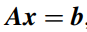
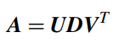
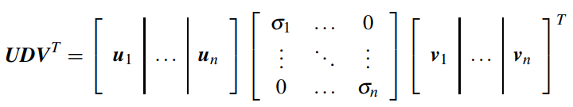

TSVD(Truncated SVD)
For system:

Slide 56
TSVD(Truncated SVD)
Denote $A_{k}$:
$$A_{k}=\sum_{i=1}^{k}{σ_{i}u_{i}v_{i}^{T}}$$
then $A_{k}$ is the best rank k approximation of the matrix A:
$$A_{k}=\min_{M}{\left\|A−M\right\|}_{F}, with rank\left(M\right)=k$$

Slide 57
Conclusion
Local surface fitting to 3D points
Mesh reconstruction
Skin weights computation from examples

Slide 58
Resources
Course notes on least squares
Fred Pighin
http://graphics.stanford.edu/~jplewis/lscourse/
Learn from data
Yaser S. Abu-Mostafa
Leature notes on least squares
Dmitriy Leykekhman
http://www.math.uconn.edu/~leykekhman/courses/MATH3795/Lectures/Lecture_8_Linear_least_squares_orthogonal_matrices.pdf

Slide 59
Resources
Sorkine O, Cohen-Or D. Least-squares meshes[C]//Shape Modeling Applications, 2004. Proceedings. IEEE, 2004: 191-199.
James D L, Twigg C D. Skinning mesh animations[C]//ACM Transactions on Graphics (TOG). ACM, 2005, 24(3): 399-407.

Slide 60
Thanks!

